Slide 1

detection System
P
L
A
G
………………

Slide 2
Table of content
01 INTRODUCTION
02 TEAM MEMBERS
03 WHAT IS PLAG CHECKER
04 TOOLS AND TECHNOLOGY USED
05 CONCLUSION

Slide 3
INTRODUCTION
Working on a project named as PLAGCHECK.
It is used to check the plagiarism percentage and Unique Content Percentage in the assignment .
Detect plagiarism in written content by comparing it to an extensive database of sources, publications, and online materials.

Slide 4
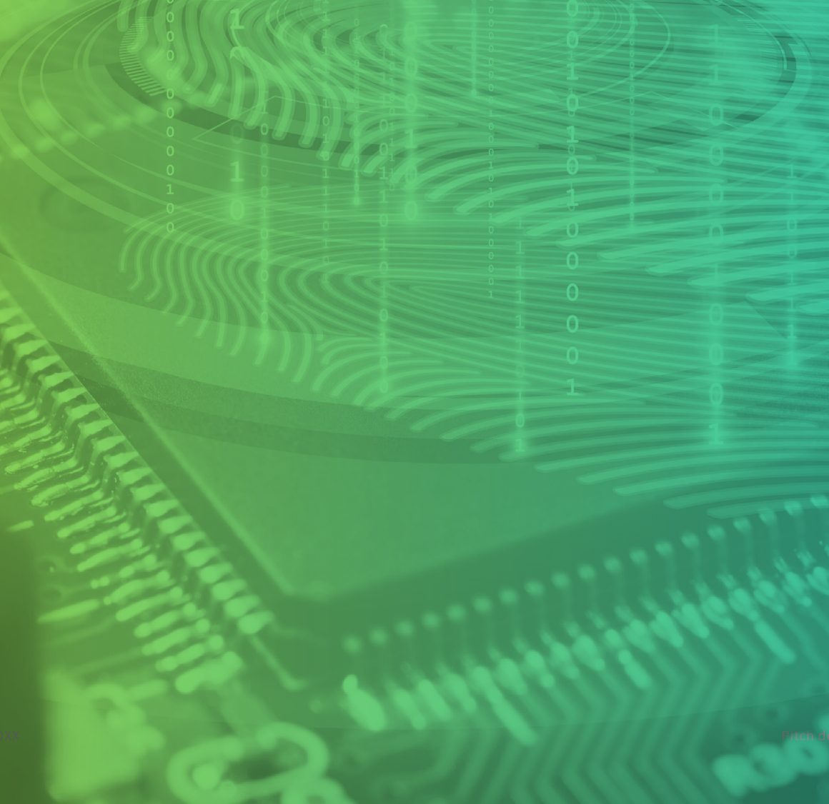
Team members
Mayank Singhal
Shivanand
Arpit gupta
Harshvardhan Gupta
Anand Raj

Slide 5

What is plagiarism?
P
L
A plagiarism checker is a software tool or online service designed to detect and identify instances of plagiarism in written content. Plagiarism is the act of copying someone else's work, ideas, or intellectual property and presenting it as one's own without proper attribution or permission. Plagiarism can occur in various forms, including copying text directly, paraphrasing without proper citation, or using someone else's ideas or intellectual property without giving credit.
A
G

Slide 6
Problem Statement
Plagiarism is a widespread issue in the academic and professional world, leading to a lack of originality, ethical concerns, and intellectual property violations. To address this problem, there is a need for an efficient and accurate plagiarism detection system using machine learning techniques. The project aims to develop a robust and scalable plagiarism detection solution that can identify instances of plagiarism in various forms of text, such as essays, research papers, articles, and more.

Slide 7
Tools / Technology Used
Machine learning and NLP
Frontend:--Html , css and javascript
Library:--Pandas Matplotlib
Framework:--Django NLTK

Slide 8
Machine learning and NLP
Machine learning is a method of data analysis that automates analytical model building. It is a branch of artificial intelligence based on the idea that systems can learn from data, identify patterns and make decisions with minimal human intervention.
NLP stands for Natural Language Processing, which is a part of Computer Science, Human language, and Artificial Intelligence. It is the technology that is used by machines to understand, analyse , manipulate, and interpret human's languages.

Slide 9
NLTK(Natural Language Toolkit)
NLTK is a Python library that provides tools and resources for working with human language data. It's valuable for text preprocessing and linguistic analysis.

Slide 10
Pandas
Pandas is an open-source library in Python that is made mainly for working with relational or labeled data both easily and intuitively. It provides various data structures and operations for manipulating numerical data and time series. This library is built on top of the NumPy library of Python. Pandas is fast and it has high performance & productivity for users.

Slide 11
MATPLOTLIB
Matplotlib is an amazing visualization library in Python for 2D plots of arrays. Matplotlib is a multi-platform data visualization library built on NumPy arrays and designed to work with the broader SciPy stack.

Slide 12
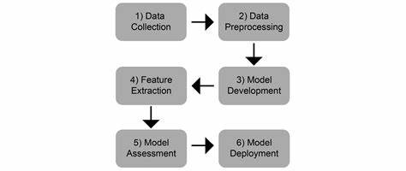
STEPS INVOLVED IN NLP

Slide 13
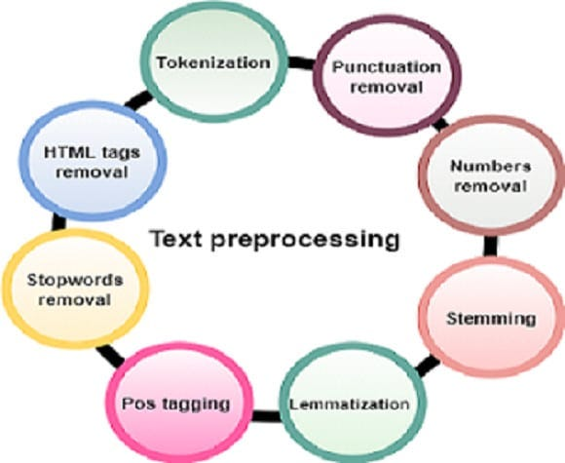
TEXT PREPROCESSING

Slide 14
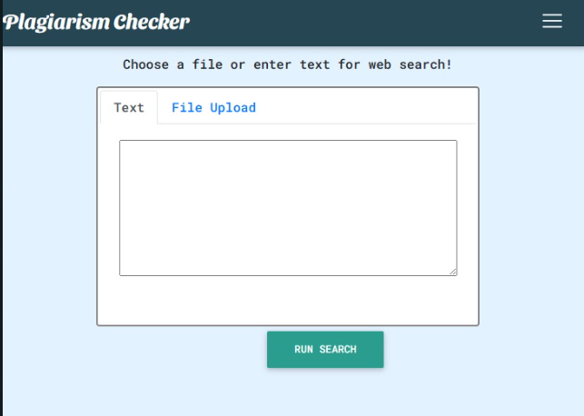
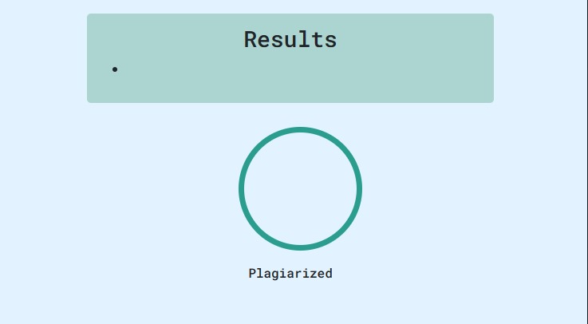
Screenshot

Slide 15


